Slide 1
A Garbage Can Model of Congress

Slide 2
Model Overview
Initialize Legislative Body
legislators and party affiliations: issue priorities and positions
network generation: preferential attachment with homophily
Process 200 proposals
Random legislator proposes random solution
Draft circulation (simulated annealing revision)
Committee revision (simulated annealing)
Floor vote

Slide 3
Legislator Issue priorities generation (ideology)
N = number of issues (75 for calibrated model)
j = number of prioritized positions (10 for calibrated model)
seed priorities = [3, 5, 7, ... 2*j+1, 1, 1, ... 1], length N
Iterate N² times, incrementing priorities probabilistically, using preferential attachment (pdf of priorities at each iteration)
normalize to [0,1]
parties prioritize different issues

Slide 4
Party and Legislator Positions
Pos_{green} = 0xb1111 = 15 for all Green and Yellow party priorities
Pos_{yellow} = 0 for all Green and Yellow party priorities
Legislator position = Party position for ideology issues, random otherwise

Slide 5
Network Generation
For each agent i:
Homophily: find S such that similarity between i and j in S is greater than threshold
similarity is average of position differences, priority-weighted
position difference on a binary tree (i.e., MSB -> 50% and LSB -> 6.125%)
5 times: Perform preferential attachment of i to S (pdf of degree for j in S)(Barabasi and Albert 1999)

Slide 6
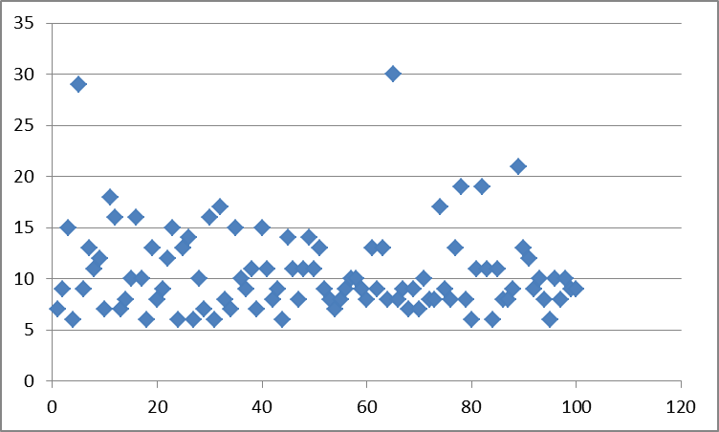
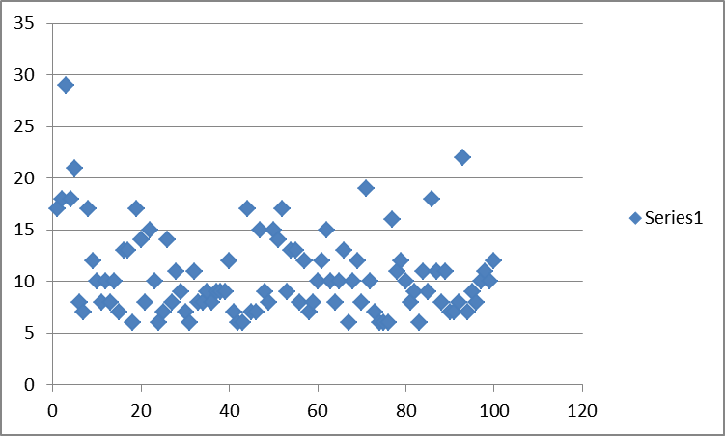
Degrees and Network Views
network views here

Slide 7
Proposal and Draft Circulation
Randomly pick a legislator to sponsor a bill
Legislator sponsors a bill on any issue not already passed into law
Bill starts as a single-issue vector, with the sponsor’s position
Cosponsors = edges in sponsor’s network
Bill is revised by simulated annealing; cosponsors’ satisfaction is the objective/energy function

Slide 8
Revision by SA
change: random position on any open issue, or bit inversion if issue already in bill → issue dimensionality of the bill increases with SA
Metropolis algorithm (accept change if lower energy, otherwise with P = e^{-ΔE/kT})
Choose best of all points visited
E = reviewers’ dissatisfaction with bill
k = -0.1/ln(1/2)
T_{max} = 1
Linearly decreasing temperature and time schedule

Slide 9
Committee Circulation
Reviewers: any legislator for whom the bill’s topical issue is in their top 4 priorities
Committee of random 5 if no reviewers meet criteria
Revise by simulated annealing

Slide 10
Voting
Legislator ‘aye’ when satisfaction > 0.5
Simple majority passes
Aggregate satisfaction with bill can be > 0.5, but not get a majority vote
When bill made into law, issues removed from the open issues list

